Slide 1
Chapter 6
The Economics of Political Action

Slide 2
The Size and Growth of the
U.S. Government

Slide 3
Government Spending as a Share of the U.S. Economy: 1930–2019
The following slide shows total government spending (federal, state, and local) as a share of the US economy.
Total government spending accounted for only 9.9% of GDP in 1930; only one third of this spending was at the federal level.
Government spending, particularly at the federal level, soared from 1930 to 1980. Total government spending rose from 9.9% of GDP in 1930 to 33.7% in 1980 (more than 3 times its 1930 level).
After remaining fairly constant between 1980 and 2000, the size of government increased substantially to 40.5 percent in 2010 and 36.2 percent in 2019.

Slide 4
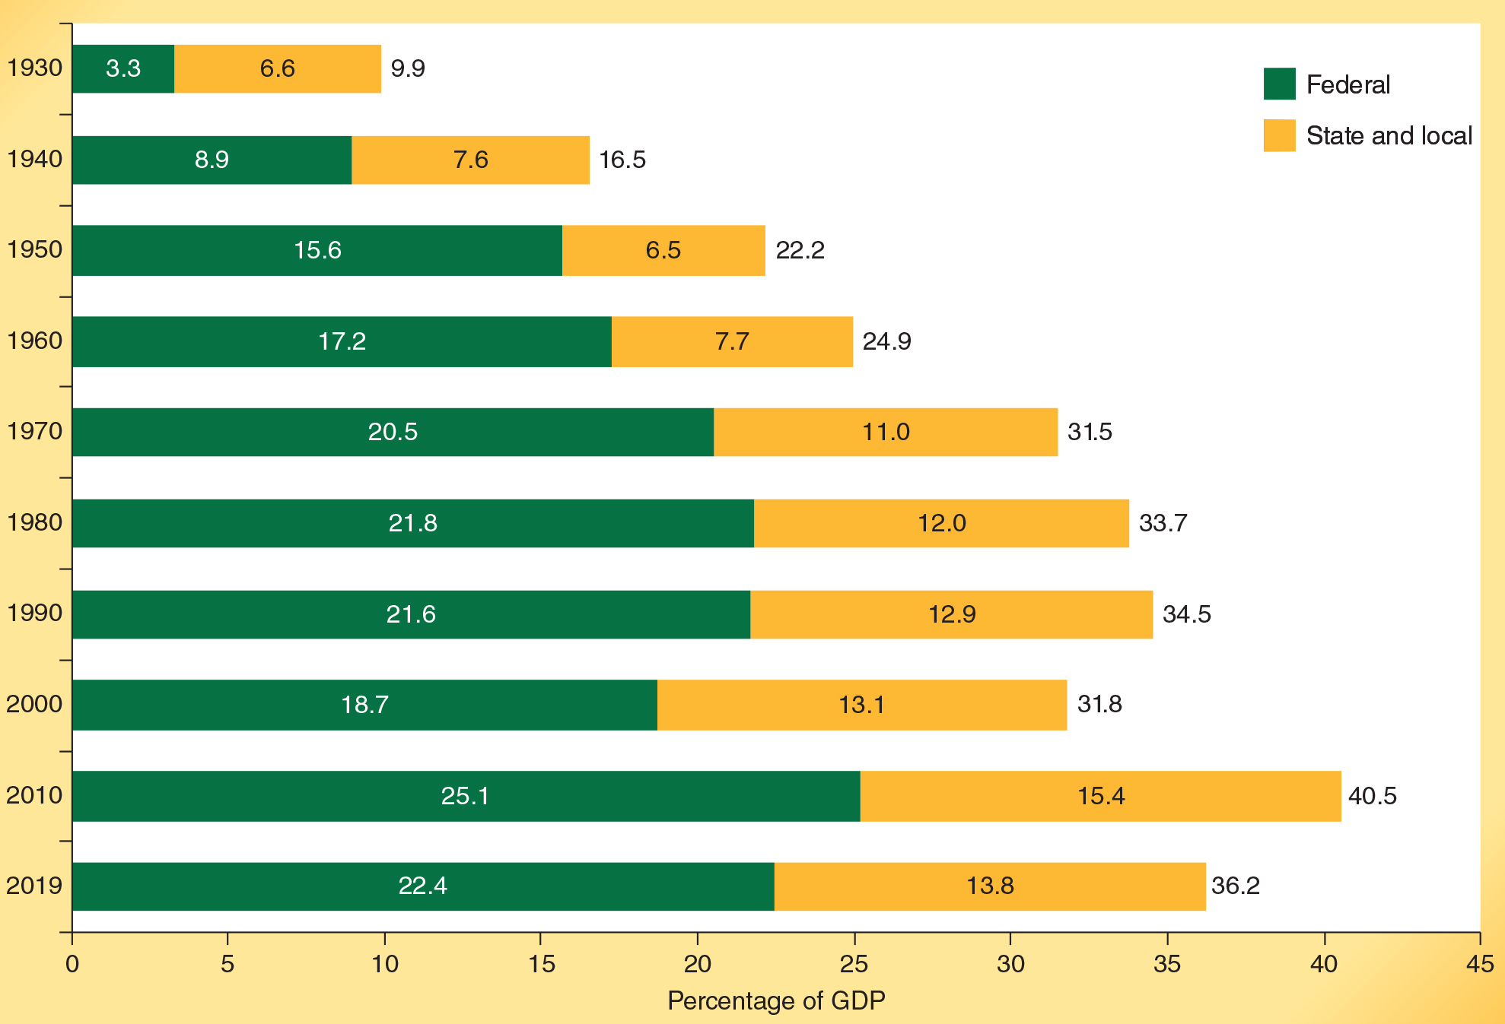
The Size of the US Government: 1930-2019
Source: Bureau of Economic Analysis, www.bea.gov. Grants to state and local governments are included in federal expenditures. Individual data may not add to total due to rounding.

Slide 5
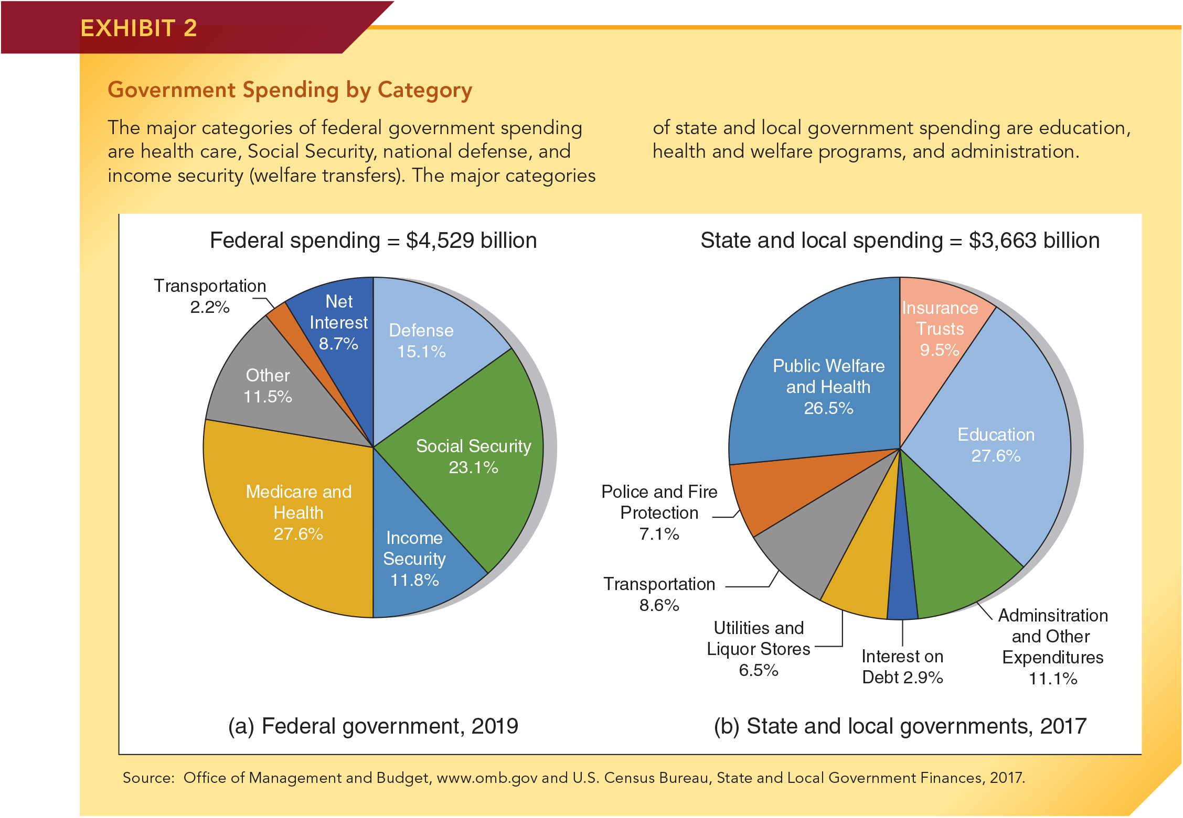
How the Federal Government Spends, 2019
Source: Office of Management and Budget, www.omb.gov

Slide 6
How State and Local Governments Spend, 2017
Source: U.S. Census Bureau, State and Local Government Finances, 2017

Slide 7
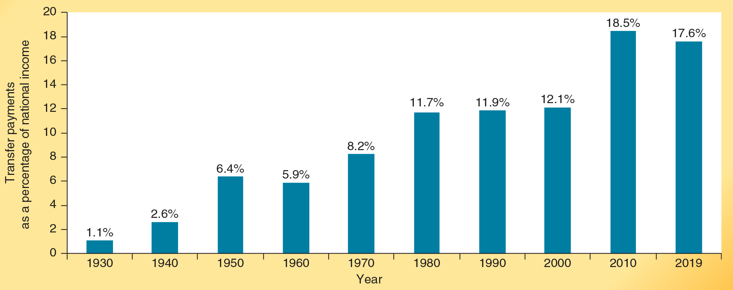
The Growth of Government Transfer Payments
Transfer payments tax income from some and transfer it to others.
As is illustrated here, government transfer payments have grown persistently during the past eight decades.
Source: Bureau of Economic Analysis, http://www.bea.gov.
Notes:
Given the size and growth of government, understanding how the political process works and how it is likely to affect the economy is vitally important. The remainder of this chapter will address this issue.

Slide 8
Similarities and Differences Between Political and Market Allocation

Slide 9
Similarities Between Government and Markets
Similarities between the two sectors:
Competition is present in both the government and market sectors.
Scarcity is present in both sectors. If the government uses resources to provide a good, those resources are unavailable for the production of other goods. This is true even if the good is provided free of charge to certain consumers.
Notes:
Competition is present in the government sector, just as it is in the market sector. The nature of the competition and criteria for success differ, but intense competition is present in both. In the government sector, politicians compete for elective office. Bureau chiefs and agency heads compete for larger budgets. Government employees compete for promotions and higher pay rates. Perhaps most importantly, business, labor, and other special interest groups compete for program funding, favorable bureaucratic rulings, and other political favors that serve their narrow interests.

Slide 10
Differences Between Government and Markets
Differences between the two sectors:
In the market sector, there is generally a one-to-one link between payment for and consumption of goods. Government allocation can break this linkage.
Private sector action is based on mutual agreement; public sector (when democratic) is based on majority rule.
When collective decisions are made legislatively, voters must choose among candidates who represent a bundle of positions on issues.
This greatly limits the power of individual voters to make their preferences count on specific issues.
There is seldom a bundle-purchase problem in markets.
Notes:
In the market sector, goods are allocated to those who are willing to pay the price: there is a one-to-one relationship between a person’s payment and receipt of a good. This is often not the case when decisions are made politically. Sometimes goods are allocated to people even if they have paid little or nothing to cover their cost. In other instances, however, individuals are required to pay dearly for a government program even though they derive few, if any, benefits from it.
Second, private-sector action is based on mutual agreement; public-sector action is based on majority rule. In the market sector, when two parties engage in trade, their actions are voluntary and motivated by the expectation of mutual gain. Corporations like Exxon and Microsoft, no matter how large or powerful, cannot take income from you or force you to buy their products. Mutual gain is the foundation for market exchange. In contrast, political action is based on majority rule, either through direct voting or through legislative procedures involving elected representatives. If a legislative majority decides on a particular policy, the minority must accept the policy and help pay for it, even if they strongly object. Political action, even when it is democratic, creates “losers” as well as “winners.”
Third, when choices are made politically, voters face a “bundle purchase” problem. They must choose among candidates who represent a bundle of positions on issues. On election day, the voter cannot choose the views of one politician on healthcare and agricultural subsidies for example, and simultaneously choose the views of a different politician on social security reform and national defense. This greatly limits the voter’s power to make his or her preferences count on specific issues. The situation in markets is quite different. A buyer can purchase some groceries or clothing from one store, while choosing related items from different suppliers.

Slide 11
Differences Between Government and Markets
Differences between the two sectors:
Income and influence are distributed differently in the market and government sectors.
In the market place, people are able to purchase more goods and services when they have larger incomes.
In the political sector, those able and most willing to use their time, persuasive skills, organizational abilities, and financial contributions to help politicians get votes will have more political influence.
Notes:
Income and influence are distributed differently in the two sectors. People who supply more highly valued resources in the marketplace have larger incomes. The number of these dollar “votes” earned by a person in the marketplace will reflect his or her abilities, ambitions, skills, past savings, inheritance, good fortune, and willingness to produce for others, among other things. In contrast, in a democratic setting, one citizen, one vote is the rule. But there are ways other than voting to influence political outcomes. People can donate their money and time to help a campaign. They can also try to influence friends and neighbors, write letters to legislators, and speak in public on behalf of a candidate or cause. The greatest rewards of the political process go to those best able and most willing to use their time, persuasive skills, organizational abilities, and financial contributions to help politicians get votes. People who have more money and skills of this sort—and are willing to spend them in the political arena—can expect to benefit themselves and their favorite causes more handsomely.

Slide 12
Political Decision Making:
An Overview

Slide 13
Public Choice Analysis
Public Choice analysis:
  Applies the tools of economics to the political process in order to provide insight concerning how the process works.
Self-interested behavior is present in both market and political sectors.
The political process can be viewed as a complex interaction among three groups:
  voter-taxpayers
  politicians
  bureaucrats
Notes:
Public-choice analysis is a branch of economics that applies the principles and methodology of economics to the operation of the political process. Over the past 60 years, research in this area has greatly enhanced our understanding of how the political process works and the structure of the outcomes it generates. Just as economists use self-interest and the structure of incentives to analyze markets, public-choice economists use them to analyze political choices and the operation of government. After all, the same people make decisions in both sectors. If self-interest and the structure of incentives influence market choices, there is good reason to expect that they will also influence choices in a political setting.

Slide 14
The Voter-Consumer
The Voter-Consumer:
Voters will tend to support those candidates who they believe will provide them with the most government services and transfer benefits, net of personal costs.
Rational Ignorance Effect:
Recognizing their vote is unlikely to be decisive, most voters have little incentive to obtain information on issues and alternative candidates.
Because of the rational ignorance effect, voters will be uninformed on many issues. Such issues will exert little influence on their political decision-making process.
Notes:
Self-interest dictates that voters, like market consumers, will ask, “What can you do for me and my goals, and how much will it cost me?” The greater the voter’s perceived net personal gain from a particular candidate’s election, the more likely it is that the voter will favor that candidate. In contrast, the greater the perceived net economic cost imposed on the voter by the positions of a candidate, the less inclined the voter will be to support the candidate. Other things being equal, voters will tend to support those candidates who they believe will provide the most government services and transfer benefits to them and their favorite causes, net of costs.
Realizing that their votes will not affect the outcome, individual voters have little incentive to spend much effort seeking the information needed to cast an informed ballot. Economists refer to this lack of incentive as the rational ignorance effect. As the result, most voters simply rely on information supplied to them freely by candidates (via political advertising) and the mass media, as well as conversations with friends and coworkers.

Slide 15
The Politician-Supplier
The Politician-Supplier:
Winning elections will be a primary motivation of politicians.
Rationally uninformed voters often must be convinced to “want” a candidate.
Legislative bodies, like a Board of Directors:
establish the general direction of policy,
appoint and supervise bureaucrats who carryout the day-to-day operations of government, and,
set the budgets of agencies and bureaus.
Just as profits are the lifeblood of the market entrepreneur, votes are the lifeblood of the politician.
Notes:
What motivates political candidates and officeholders? Economics indicates that their actions and political positions will be heavily affected by the pursuit of votes. No doubt, many of them genuinely care about the “public interest” and the quality of government, but they need to be elected to achieve their objectives, whatever they may be. Clearly, politicians have a strong incentive to give voters a reason to support their candidacy. As Stanford economist Thomas Sowell puts it: The first lesson of economics is scarcity: there is never enough of anything to fully satisfy all those who want it. The first lesson of politics is to disregard the first lesson of economics.
Moreover, if a candidate is going to be successful, their positive attributes must be brought to the attention of rationally ignorant voters focused on their families, jobs, various civic activities, and local sports teams (which are probably more entertaining). The successful candidate needs to spend money on a campaign. It is not unusual for an incumbent candidate for the U.S. Senate to spend $15 million or more seeking to win an election. In other words, votes are the necessary objective of politicians, but money helps them get those votes.

Slide 16
Government Bureaucrats
Civil servants (government bureaucrats) as political participants:
Bureaucrats (individuals who handle the day-to-day operations of government) seek promotions, job security, power, etc.
The interests of bureaucrats are often complementary with those of the interest groups they serve.
Larger budgets and program expansion generally serve the interests of bureaucrats.
Notes:
Like other people, bureaucrats who staff government agencies usually want to see their own agency’s goals furthered. Economic analysis suggests there is a strong tendency for government bureaucrats and employees to want to expand their budgets and their authority well beyond what would be economically efficient. Indeed, analysts recognize that bigger programs often have strong, organized political backing. In contrast “efficiency has no political constituency.”
Legislative bodies are in charge of overseeing these bureaus, but the individual legislators themselves generally know little about the true costs of agency decisions, especially the costs to those regulated. This makes it even more likely that bureaucrats will be able to get funding and authority beyond what’s economically efficient.

Slide 17
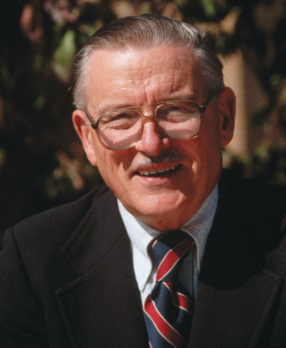
Outstanding Economist: James Buchanan
• The 1986 winner of the Nobel Prize in Economics, James Buchanan might properly be called the “father of public choice economics.” Rather than assuming that voters, elected political officials, and bureaucrats are “saints” seeking to promote the common good, Buchanan assumed that the key political players responded to the structure of incentives. As he put it, public-choice analysis is “government without the romance.”
• Buchanan’s most famous work, The Calculus of Consent (1962), coauthored with Gordon Tullock, argues that unless constitutional rules are structured in a manner that will bring the self-interests of the political players into harmony with the wise use of resources, government action will often be counterproductive. Given the continued growth of government, Buchanan’s work is now perhaps more relevant than at any time in American history.
Wally McNamee /Corbis Historical/Getty Images

Slide 18
When the Political Process
Works Well

Slide 19
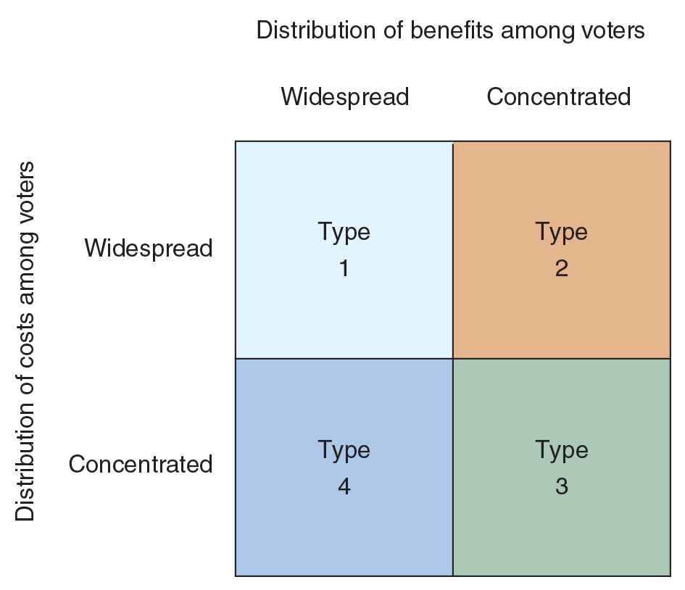
Distribution of Benefits and Costs Among Voters
Consider how the 4 possible distributions of benefits and costs among voters affect the operation of representative government.
When benefits or costs are either both widespread or concentrated (type 1 or type 3), representative government tends to undertake projects that are productive and reject those that are unproductive.
When benefits are concentrated and costs widespread (type 2), representative government is biased towards the adoption of counterproductive (inefficient) activity.
Last, when benefits are widespread but the costs are concentrated (type 4), the political process often rejects productive projects.
Notes:
When voters pay in proportion to benefits received, all voters will gain if the government action is productive, and all will lose if it is unproductive. When the benefits and costs derived by individual voters are closely related, the voting process will enact efficient projects while rejecting inefficient ones. When voters pay in proportion to the benefits they receive, there will tend to be harmony between good politics and sound economics.

Slide 20
When Voting Works Well
Other things constant, legislators will have a strong incentive to support political actions that provide voters with large total benefits relative to costs.
If a government project is productive, it will be possible to allocate the project’s cost so that all voters will gain.
When voters pay in proportion to benefits received, all voters will gain if the government action is productive (and all will lose if it is unproductive). Under these circumstances, there is a harmony between good politics and economic efficiency.
Notes:
How might the cost of a government service be linked to the benefits received? User charges, which require people who use a service more to pay a larger share of the cost, provide one way. User charges are most likely to be levied at the local level. Local services such as electricity, water, and garbage collection are generally financed with user charges. Sometimes the intensity of the use of a service and the amount paid for it can be linked by specifying that the revenue from a specific tax be used for a designated purpose. For example, many states finance road construction and maintenance with the revenue collected from taxes on gasoline and other motor fuels. The more an individual drives— getting more benefits from the roads—the more that individual pays.

Slide 21
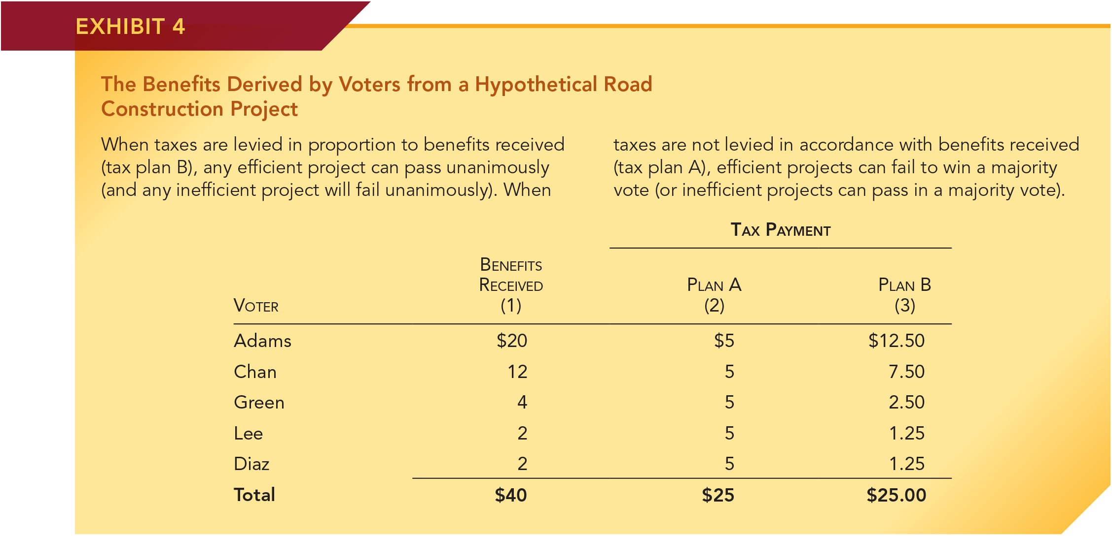
Benefits Derived by Voters from
Hypothetical Road Project
Consider this government program. The total benefits ($40) exceed the tax cost ($25). It is, therefore, an efficient program.
Under plan A, the tax cost ($5) imposed on each voter is the same. If decided by majority vote, the project would be rejected by a 3 to 2 margin.
Under plan B each voter pays in proportion to benefits received. In this case, all voters gain and the program would pass unanimously.
This example shows that harmony between politics and economic efficiency exists when costs are allocated in proportion to benefits.

Slide 22
Questions for Thought:
1. “The average person is more likely to make an informed choice when he or she purchases a laptop computer than when he/she votes for a congressional candidate.”
– Evaluate this statement.
2. Does the motivation for political action differ from market action? Are people more greedy when they make market choices than when they make political choices?

Slide 23
Questions for Thought:
3. “Government action is based on majority rule, whereas
market action is based on mutual consent.”
Is this statement true or false? Is this point important? Why or why not?
4. When the cost of a project is allocated among voters in direct proportion to the benefits derived, will democratic political decision making tend to accept projects that are efficient? Will it tend to reject projects that are inefficient? Discuss.

Slide 24
Questions for Thought:
5. (True or false) Market allocation and the political process differ in that:
(a) Competition is present in markets, but not in the political sector.
(b) Scarcity is a constraint in markets but not in the political sector.
(c) There is a one-to-one link between payment for and receipt of a good in markets, but this is not always true in the political sector.
(d) Voter-consumers are generally well informed, but market decision makers are not.
(e) Money influences market outcomes, but not political outcomes.

Slide 25
When the Political Process
Works Poorly

Slide 26
When Voting Conflicts with Economic Efficiency: Special Interest Effect
A special interest issue generates large personal benefit for a small number of constituents while imposing a small individual cost on a large number of others.
Interest group members feel strongly about issues that provide them with substantial personal benefits. Such issues will dominate their political choices.
In contrast, voters bearing the cost of such legislation often are uninformed on the issue because it exerts only a small impact on their personal welfare and because of the rational ignorance effect.
Notes:
Because their personal stake is large, members of the interest group (and lobbyists representing their interests) will feel strongly about various special interests. Many of the special-interest voters will vote for or against candidates strictly on the basis of whether they are supportive of their positions. In addition, interest groups are generally an attractive source of campaign resources, including financial contributions. In contrast, most of the other, largely rationally ignorant, voters will either not know or will care little about special-interest issues. While politicians would gain little from support of the rationally ignorant and unorganized majority, organized interest groups are eager to provide cooperative politicians with vocal supporters, campaign workers, and, most important, financial contributions.
As a result, politicians have a strong incentive to support legislation that provides concentrated benefits to special-interest groups at the expense of disorganized groups (like the bulk of taxpayers and consumers).

Slide 27
When Voting Conflicts with Economic Efficiency: Special Interest Effect
Politicians have a strong incentive to favor the views of special interests even if the action is inefficient.
Logrolling and pork-barrel legislation strengthen the special interest effect.
Politicians will tend to favor established businesses with a stronger record of political contributions and better knowledge of lobbying techniques than newer innovative upstart firms. For example:
Uber vs. taxi industry
Tesla vs. auto dealers
Notes:
Logrolling: The exchange between politicians of political support on one issue for political support on another.
Pork-barrel legislation: A package of spending projects bundled into a single bill. It is often used as a device to obtain funding for a group of projects intensely desired by regional or interest groups that would be unlikely to pass if voted on separately.

Slide 28
The Special Interest Effect:
A “Sweet” Example
The sugar program provides an example of the special interest effect.
Price supports and import quotas cause the price of sugar in the U.S to be 50 to 100 percent above the world level.
Approximately 20,000 sugar growers derive huge personal gains (average = $85,000 per grower) while imposing a small personal cost ($25 per household) on sugar consumers.
The sugar lobby contributed more than $16 million to politicians during the most recent election cycle.
The program continues even though it is counterproductive.

Slide 29
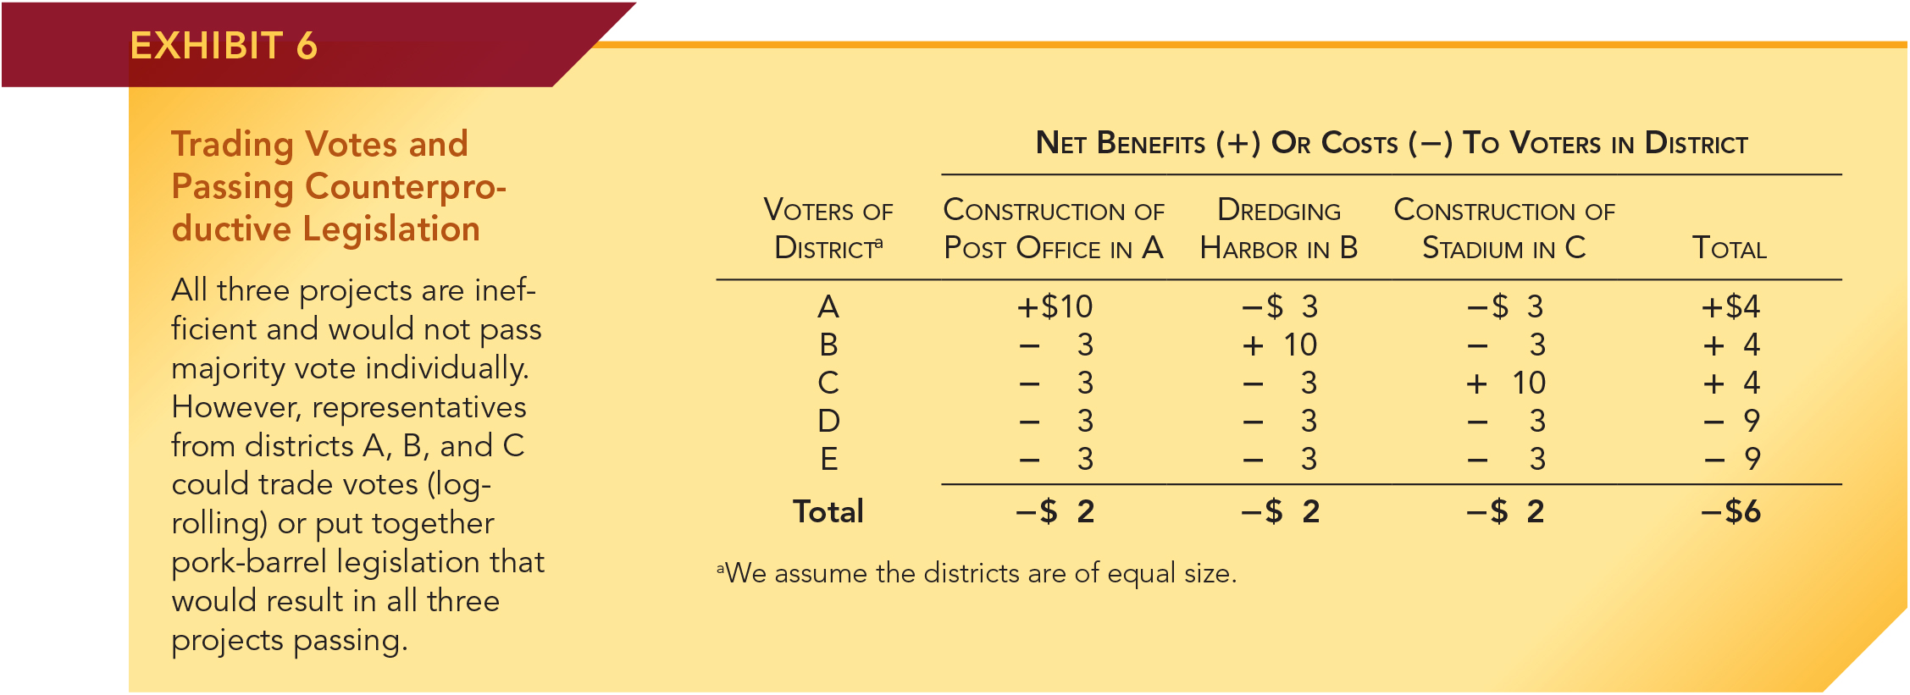
Trading Votes and Passing
Counterproductive Legislation
Consider a bill in Congress that would put a post office in district A, dredge a harbor in B, and build a new stadium in district C.
Benefits to A, B, and C voters vary by project. In total, voters in A, B, and C districts come out ahead despite the costs of paying taxes for activities in other districts – if they agree to vote together.
With this bill, there are no benefits to voters in D and E; further, the sum of benefits & costs for all voters together is negative.
With majority rule, representatives from districts A, B, and C, can, and often will, pass counterproductive legislation.
Notes:
The political incentive to support special interest projects, including those that are counter-productive, is even stronger than this simple numeric example. As the result of the rational ignorance effect, those harmed by pork-barrel and other special-interest policies will often be unaware of the adverse impact the projects exert on their welfare. Moreover, the incentive to cater to special interests often deters entry of innovative firms and weakens the competitive process. Older, more established businesses have built a stronger record of political contributions, have more knowledge of lobbying techniques, and have developed a closer relationship with powerful political figures. Predictably, the more mature firms generally have more political clout than newer upstarts and will use it to deter innovative rivals.

Slide 30
When Voting Conflicts with Economic Efficiency: Shortsightedness Effect
Shortsightedness Effect:
Issues that yield clearly defined current benefits at the expense of future costs that are difficult to identify.
The political process is biased toward the adoption of such proposals even when they are inefficient.
The shortsightedness effect explains why politicians will find debt financing and unfunded promises attractive—they make it possible for politicians to provide current benefits to voters without levying an equivalent amount of current taxes to pay for them.
Notes:
Shortsightedness effect: The misallocation of resources that results because public-sector action is biased (1) in favor of proposals yielding clearly defined current benefits in exchange for difficult-to-identify future costs and (2) against proposals with clearly identifiable current costs that yield less concrete and less obvious future benefits.

Slide 31
When Voting Conflicts with Economic Efficiency: Rent Seeking
Rent Seeking:
Actions by individuals and interest groups designed to restructure public policy in a manner that will either directly or indirectly redistribute more income to themselves.
Widespread use of the taxing, spending, and regulatory powers of government that favor some at the expense of others will encourage rent seeking.
When the government is heavily involved in the granting of contracts, subsidies, tax credits, low-interest loans, regulatory favors, and other forms of government intervention, then business firms, labor organizations, and other well-organized interests will compete for the government favors.
Rent seeking diverts resources away from productive activities. The output of economies with substantial amounts of rent seeking will fall below their potential.
Notes:
Rent-seeking is the term economists use to describe actions taken by individuals and groups seeking to use the political process to take the wealth of others. Perhaps “favor seeking” would be a more descriptive term for this type of activity, which generally involves “investing” resources in lobbying and other activities designed to gain favors from the government. The incentive for individuals to spend time and effort in rent-seeking will be determined by how rewarding it is. Rent-seeking will be unattractive when constitutional constraints prevent politicians from taking the property of some and transferring it to others (or forcing some to pay for things desired by others).

Slide 32
When Voting Conflicts with Economic Efficiency: Government Operated Firms
The structure of incentives and the efficiency of government operated firms and agencies
In the public sector, the absence of the profit motive reduces the incentive of producers to keep costs low. Neither is there a bankruptcy process capable of weeding out inefficient producers.
Public-sector managers are seldom in a position to gain personally from measures that reduce costs.
Because public officials and bureau managers spend other people’s money, they have less incentive to be cost-conscious.
Notes:
The incentive to keep costs low and provide customers with highly valued goods and services differs substantially between the market and government sectors. In the market sector, there is a strong incentive to produce efficiently because lower costs mean higher profits. The profit motive also provides private firms with a strong incentive to supply goods and services that are highly valued relative to their cost.
In the public sector, there is nothing like profit and loss that might be used to evaluate the performance of agencies, enterprises, and managers. Neither is there a mechanism like bankruptcy that can be counted on to eventually bring inefficient public sector operations to a halt. In fact, failure to achieve a targeted objective (for example, a lower crime rate or improvement in student achievement scores) is often used as an argument for increased public-sector funding of an agency or its programs. Furthermore, public-sector managers are seldom in a position to gain personally from measures that reduce costs. The opposite is often true, in fact. If an agency fails to spend its entire budget for a given year, not only does it have to return the extra money, but its budget for the next year is likely to be cut. Because of this, government agencies typically go on a spending spree near the end of a budget period if they discover they have failed to spend all the current year’s allocated funds.
It is important to note that the argument of internal inefficiency is not based on the assumption that employees of a bureaucratic government are lazy or less capable. Many agency managers are highly capable, diligent, and focused strongly on their mission within the agency. Rather, the inefficiency stems from the incentives and opportunities that such managers and workers face.

Slide 33
Questions for Thought:
1. What is the shortsightedness effect? How does the shortsightedness effect influence the efficiency of public sector action?
2. What is rent seeking? What types of government activities encourage rent seeking?
3. Will efficient projects necessarily be favored by a majority of voters? Why or why not?

Slide 34
Political Favoritism,
Crony Capitalism, and
Government Failure

Slide 35
Political Favoritism, Crony Capitalism, and Government Failure
As government spending, subsidies, income transfers, financial bailouts, and regulatory favors grow, businesses and other well-organized groups will expend more resources seeking to obtain government favors.
As a result, crony capitalism grows relative to market allocation.
Crony capitalism is the situation where the allocation of resources is determined by political favors rather than by consumer preferences translated through the market profit and loss system.
Notes:
Crony capitalism is the situation where the allocation of resources, and winners and losers in business, are determined by political favors rather than by consumer preferences translated through the market profit-and-loss system. Under crony capitalism, rather than providing equal treatment of individuals and businesses under the law, government uses spending, subsidies, and regulations to favor those most willing to provide political decision-makers with campaign contributions and other forms of political support. In essence, crony capitalism reflects the intermingling of government and business. The politicians use the favoritism to obtain political resources (e.g. contributions, support of organized interest groups) while the businesses use the government favors to enhance their profitability.

Slide 36
Political Favoritism, Crony Capitalism, and Government Failure
Under crony capitalism, rather than providing equal treatment of individuals and businesses under the law, government uses spending, subsidies, and regulations to favor those most willing to provide political decision-makers with campaign contributions and other forms of political support.
Economic inefficiency is the result.
Notes:
There is reason to believe that crony capitalism is an emerging problem in the United States.

Slide 37
Bootleggers and Baptists
Crony Capitalism is often driven by the bootlegger–Baptist strategy: greedy action packaged as moral behavior.
Opportunistic rent-seekers (the bootleggers) often frame their programs in a manner designed to attract support from naïve idealists (the Baptists).
They argue their programs will enhance child safety, promote energy independence, save family farms, or some other widely supported goal.
But when one looks below the surface, one discovers that these programs are about government favoritism providing handsome profits to the well organized special interest groups.
Notes:
During the era when many states and counties had bans on the sale of alcoholic beverages, the bootleggers and Baptists both supported the bans, the former because it increased the demand for their product and the latter for moral reasons.
Like the bootleggers, opportunistic rent-seekers often frame their programs in a manner designed to attract support from naïve idealists. They argue their programs will enhance child safety, promote energy independence, save family farms, or some other widely supported goal. But when one looks below the surface, you note that the programs provide favoritism that generates handsome profits for the rent-seekers.

Slide 38
Bootleggers and Baptists
Bootlegger–Baptist examples include:
Mattel incorporating costly testing procedures into the Consumer Product Safety Improvement Act of 2008.
The action increased the costs of rivals and drove used toy sellers like Goodwill out of the market.
General Electric partners with environmentalists to advocate subsidies and tax breaks for alternative energy sources.
This government favoritism increased demand for GE turbine engines, solar panels, and wind farms.
Result: GE earned $15 billion in 2010 and paid zero corporate income taxes.
Notes:
Between 1998 and 2007, Mattel had 36 costly recalls, which both damaged its reputation and added to its legal expenses. Because of this Congress passed the Consumer Product Safety Improvement Act of 2008 (CPSIA). The bill imposed new lead testing requirements on manufacturers of products ranging from apparel to home furnishings and toys.
Mattel played a central role in the writing of the CPSIA, and the act permitted Mattel to test its own products because, unsurprisingly, its lab met the specifications of the legislation it helped to formulate.
The act also provided Mattel with a sizeable advantage relative to its smaller rivals, who had to submit their products for costly testing at independent laboratories. Equally important, the testing virtually eliminated the secondhand toy and children’s clothing market. Clearly, Goodwill and other retailers of used toys and clothing with zippers, buttons, or other accessories with even a touch of paint could not afford to test these products and still make them available at economical prices. Literally, tens of millions of dollars of used toys and clothing were rendered useless and eliminated from the market. This made it possible for Mattel to charge higher prices than would have otherwise been the case.
Like many other rent-seekers, Mattel used the bootlegger–Baptist strategy to achieve its goals. They argued that the requirement would protect children from suffering great harm and benefitted from the support of consumer lobby groups. Controversy over these claims helped to divert attention away from the cost that the program was sure to impose on taxpayers and consumers. There was no evidence that even one child had suffered health damage from lead paint on toys or clothing. Nonetheless, Mattel was able to reap substantial benefits from the child safety legislation.

Slide 39
Market Entrepreneurs versus Crony Capitalists
Market entrepreneurs get ahead by providing consumers with products that are more highly valued than the resources required for their production.
Crony capitalists get ahead by providing political players with campaign contributions and other political resources in exchange for government contracts, subsidies, tax benefits, and other forms of political favoritism.
  Projects of crony capitalists will often be counterproductive.
Crony capitalism reflects government failure and undermines the legitimacy of the democratic political process.
Notes:
Market entrepreneurs have a strong incentive to serve the interests of consumers spending their own money. In order to be successful, market entrepreneurs must produce goods and services that consumers value more than the resources required for their production. When they do so, their actions are productive.
In contrast, crony capitalists have a strong incentive to serve the interests of political decision-makers spending someone else’s money. Crony capitalists succeed by providing political players with campaign contributions and other political resources in exchange for government contracts, subsidies, tax benefits, and other forms of political favoritism. Their activities will often be counterproductive.
While the cozy relationship between government contractors and political leaders is nothing new, the expanded role of the government provides reason for additional concern. Can political decision-makers really be evenhanded when they derive substantial political support from those benefiting from their spending, regulatory, and tax policies?

Slide 40
The Economic Way of Thinking About Markets and Government

Slide 41
The Economic Way of Thinking
About Markets and Government
Two key points about government:
Protective function of government:
When government protects private property, enforces contracts evenhandedly, maintains monetary stability, and refrains from regulations that restrict entry into markets, it provides the foundation for the smooth operation of markets.
Government failure:
Both political and market organization have shortcomings.
Notes:
A government that protects private property, enforces contracts evenhandedly, maintains monetary stability, and refrains from regulations that restrict voluntary exchange and entry into markets is central to the efficient operation of markets.
Second, both the market and the political process have shortcomings. There is government failure as well as market failure. As in the case of market failure, government failure reflects the situation where the structure of incentives encourages individuals to engage in counterproductive rather than productive use of resources.

Slide 42
The Economic Way of Thinking
About Markets and Government
Public choice analysis shows that there is sometimes a conflict between winning elections and following sound policies.
For some types of activities, there is reason to believe that the political action that will help one get elected will, at the same time, encourage counter-productive activities that reduce income levels.
Notes:
There is a tendency to idealize democratic governance—to focus on the stated objectives of political officials rather than the actual effects of their policies. Public-choice analysis warns against this naïve view. It focuses on how the political process really works, even if that is not how we might like for it to work. Public-choice analysis also indicates that the presence of government failure will grow as government becomes larger and more intrusive. A larger government will mean more grants, contracts, subsidies, and regulatory favors. This will create more special interest spending, rent-seeking, and crony capitalism. Public choice also highlights the importance of institutions, constitutional rules, and procedures that encourage productive political actions and restrain those that are counter-productive.

Slide 43
The Economic Way of Thinking
About Markets and Government
Understanding the strengths and weaknesses of both sectors is important if we are going to improve our current economic institutions.
The following factors often result in market failure:
Lack of competition
The following factors often result in government failure:
The special-interest effect
Externalities
Public goods
Poor information
The shortsightedness effect
Rent-seeking
Weak incentives for operational efficiency

Slide 44
Questions for Thought:
1. “Political officials will be led as if by an invisible hand to support legislation that provides concentrated benefits to interest groups at the expense of disorganized groups such as taxpayers and consumers.”
– Is this statement true or false? Why?
2. The US imposes highly restrictive sugar import quotas that result in a domestic price of sugar often two or three times the world price. The quotas benefit sugar growers at the expense of consumers. Given there are far more sugar consumers than growers, why are the quotas not abolished? Do the sugar quotas improve American living standards? Why/why not?

Slide 45
Questions for Thought:
3. How does the incentive for members of congress to spend on programs beneficial to their district compare to their incentive to control federal spending?
4. Carefully define market failure and government failure. How do they relate to idealized economic efficiency?
5. Why is deficit spending attractive to politicians?
6. What is rent-seeking? When is it likely to be widespread? How does it influence economic efficiency? Explain.

Slide 46
End of Chapter 6

